Slide 1
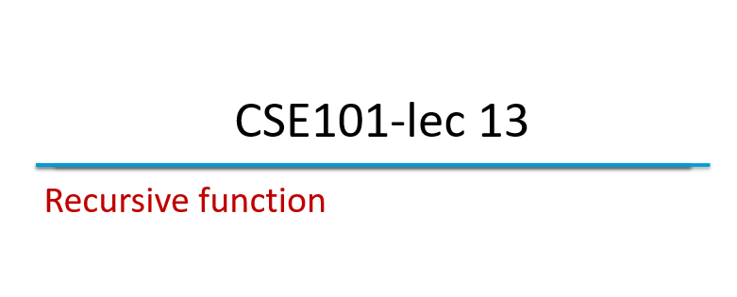

Slide 2
Outline
Recursion
Examples of recursion
Finding factorial of a number
Finding Fibonacci series up to nth term
Recursion Vs Iteration

Slide 3
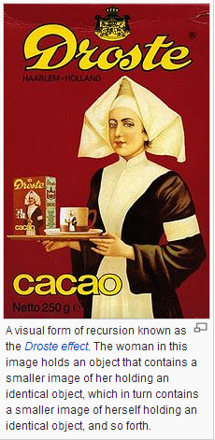
Recursion
Recursive functions
Functions that call themselves
Can only solve a base case
Divide a problem up into
What it can do
What it cannot do
What it cannot do resembles original problem
The function launches a new copy of itself (recursion step) to solve what it cannot do
Eventually base case gets solved
Gets plugged in, works its way up and solves whole problem

Slide 4
Recursion example (factorial)
Factorial of a number in mathematics
5! = 5 * 4 * 3 * 2 * 1
Another method we have studied is
For 5!, we write 5! = 5 * 4!
Then for 4!, 4! = 4 * 3!
Then for 3!, 3! = 3 * 2!
Then for 2!, 2! = 2 * 1!
Then for 1!, 1! = 1 * 0!
And if its comes to 0,
0!=1
Solve base case (1! = 0! = 1)
Values returned
120
24
6
2
1

Slide 5
Recursion example (factorial)

Slide 6
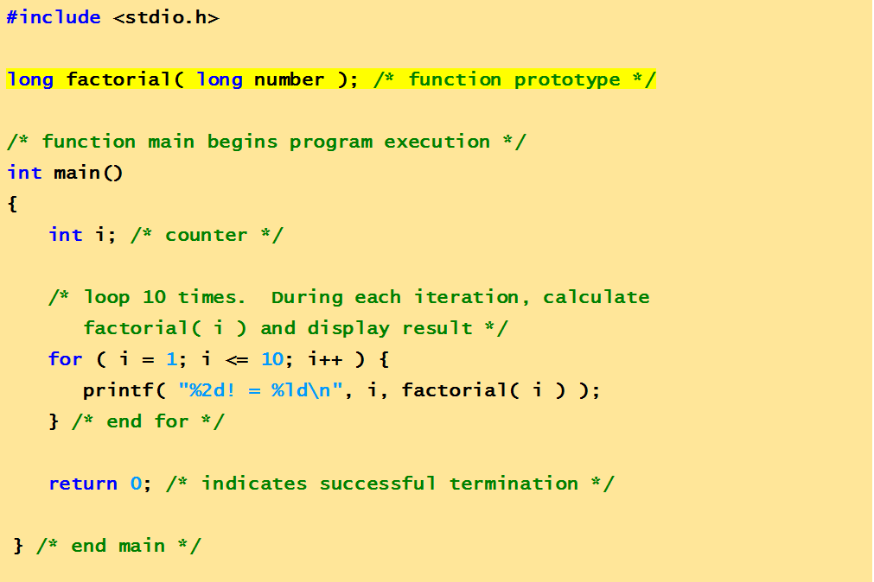
Recursion example (factorial code)
This function calculates factorial of first 10 numbers

Slide 7
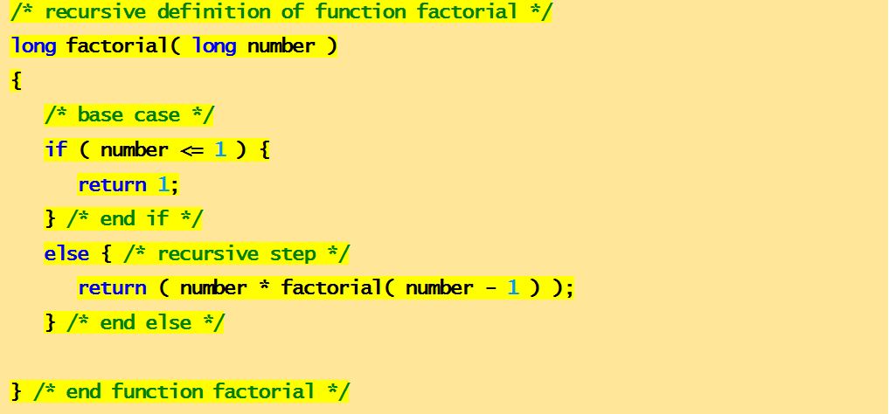
Recursion example (factorial code)
This function calculates factorial of first 10 numbers
1! = 1
2! = 2
3! = 6
4! = 24
5! = 120
6! = 720
7! = 5040
8! = 40320
9! = 362880
10! = 3628800
output

Slide 8
Recursion example (fibonacci)
What is Fibonacci series: …??
0, 1, 1, 2, 3, 5, 8...
Each number is the sum of the previous two
Can be solved recursively:
fib( n ) = fib( n - 1 ) + fib( n – 2 )
Code for the fibonacci function
long fibonacci( long n )
{
if (n == 0 || n == 1) // base case
return n;
else
return fibonacci( n - 1)+fibonacci( n – 2 );
}

Slide 9
Recursion example (fibonacci)
Set of recursive calls to fibonacci() function
f( 3 )
return
f( 2 )
+
f( 1 )
return
f( 1 )
+
f( 0 )
return 1
return 1
return 0

Slide 10
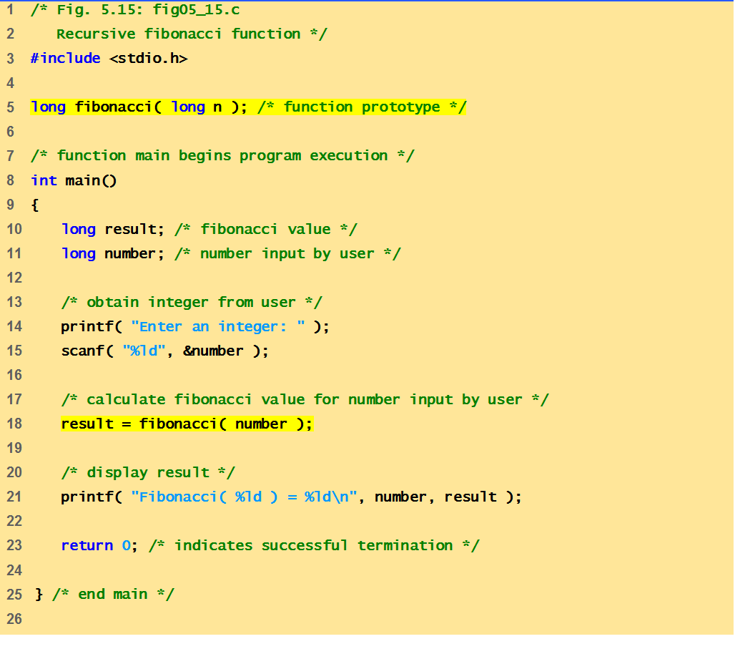
Recursion example (fibonacci code)
This function calculates fibonacci number of any given position

Slide 11
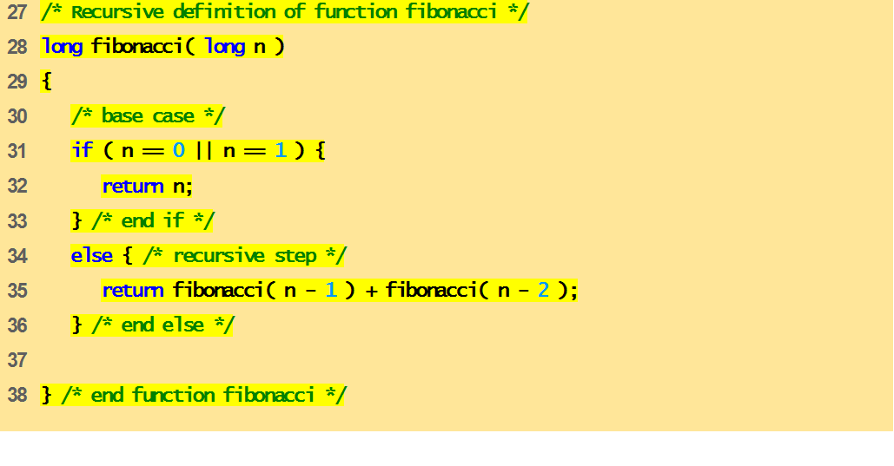
Recursion example (fibonacci code)
This function calculates fibonacci number of any given position
Enter an integer: 0
Fibonacci( 0 ) = 0
or
Enter an integer: 1
Fibonacci( 1 ) = 1
or
Enter an integer: 20
Fibonacci( 20 ) = 6765
output

Slide 12
Recursion vs. Iteration
Repetition
Iteration: explicit loop(for,while)
Recursion: repeated function calls
Termination
Iteration: loop condition fails
Recursion: base case reached
Both can have infinite loops
Balance
Choice between performance (iteration) and good software engineering (recursion)

Slide 13
Rules for recursive function
In recursion, it is essential to call a function itself
Only the user defined function can be involved in the recursion. Library function cannot be involved in recursion because their source code cannot be viewed
A recursive function can be invoked by itself or by other function.
To stop recursive function, it is necessary to base recursion on some condition, and proper termination statement such as exit() or return
The user defined function main() can be invoked recursively.

Slide 14
Next Lecture
Life and existence of a variable …??
storage classes

